Slide 1
Collaboration

Slide 2
Content
Collaboration workflows
Pushing, fetching, and pulling
Pull requests, issues, and milestones

Slide 3

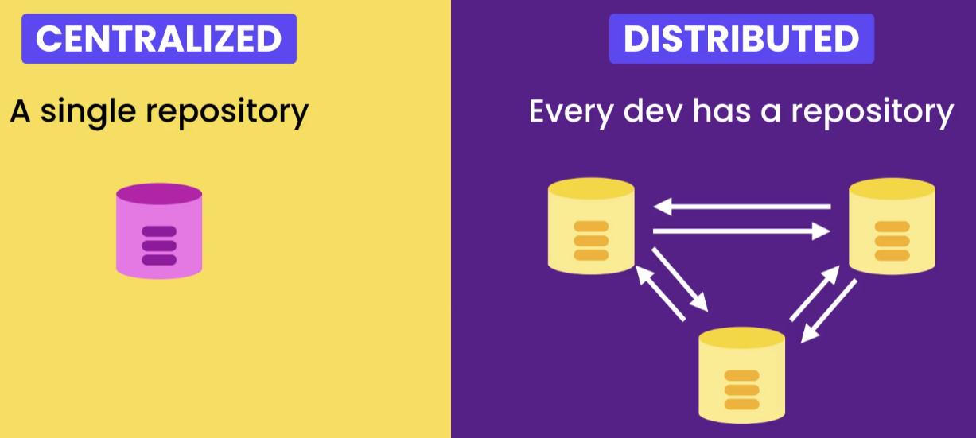
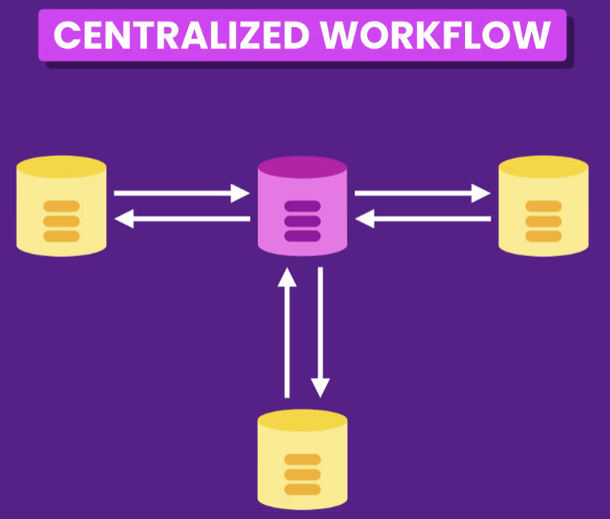
Workflows
GitHub, GitLab, etc.
Two types of VCS
Fast and no single of point of failure

Slide 4
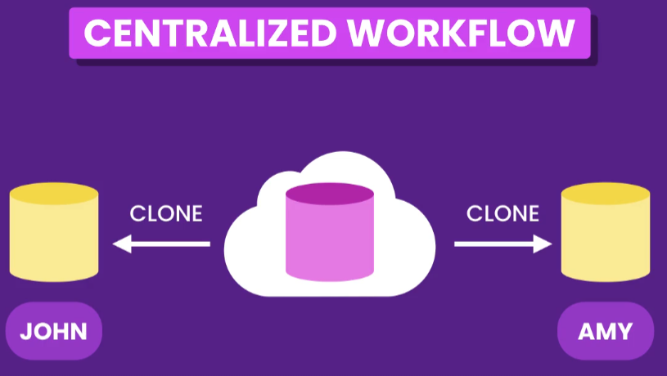
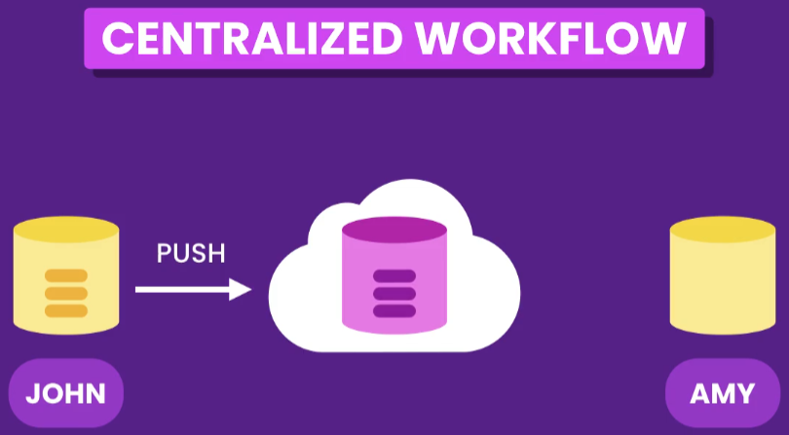
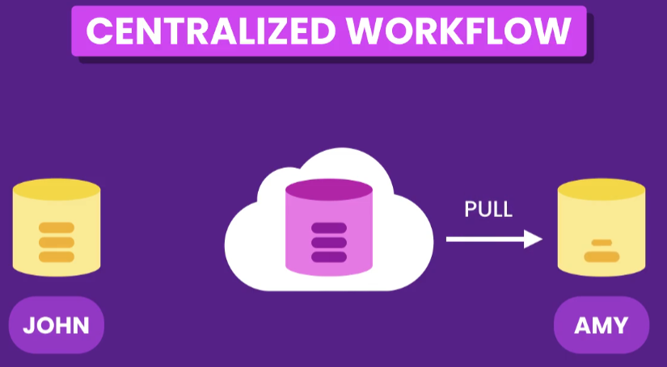
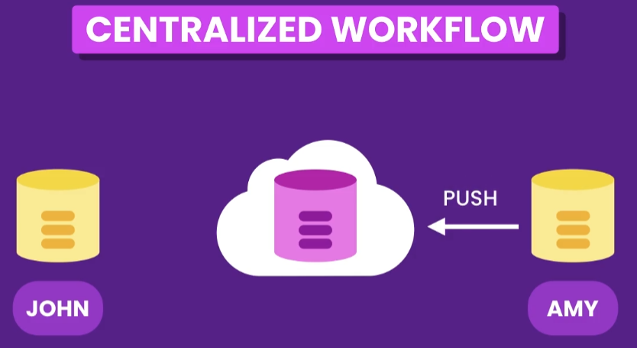
Real-World Scenario

Slide 5
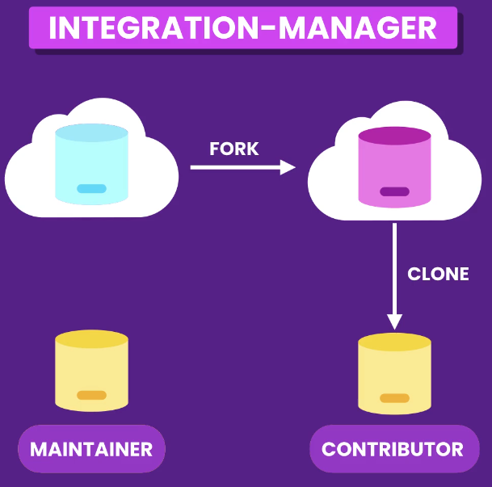
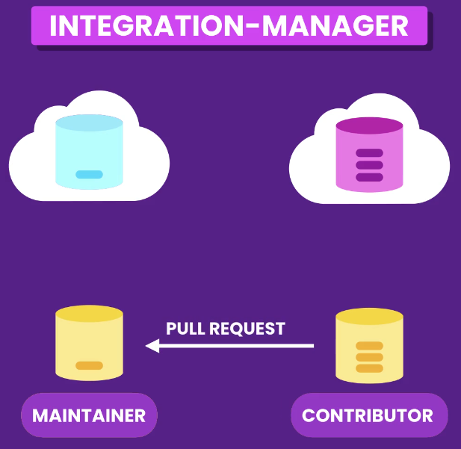
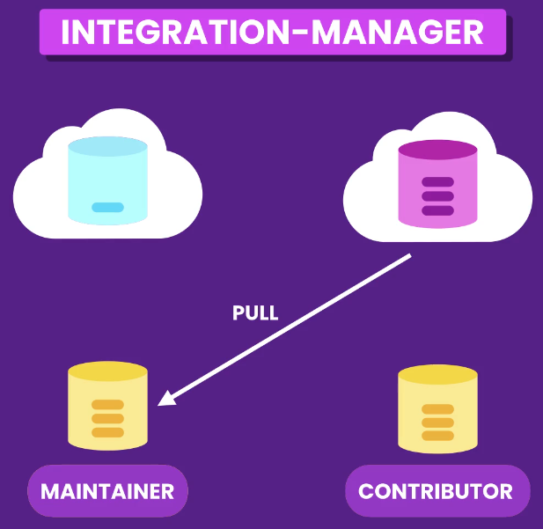
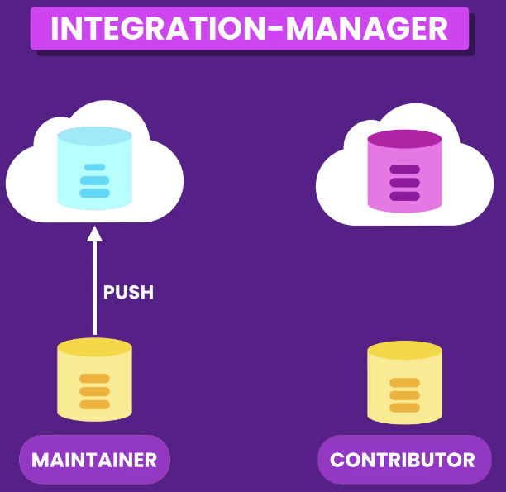

Slide 6
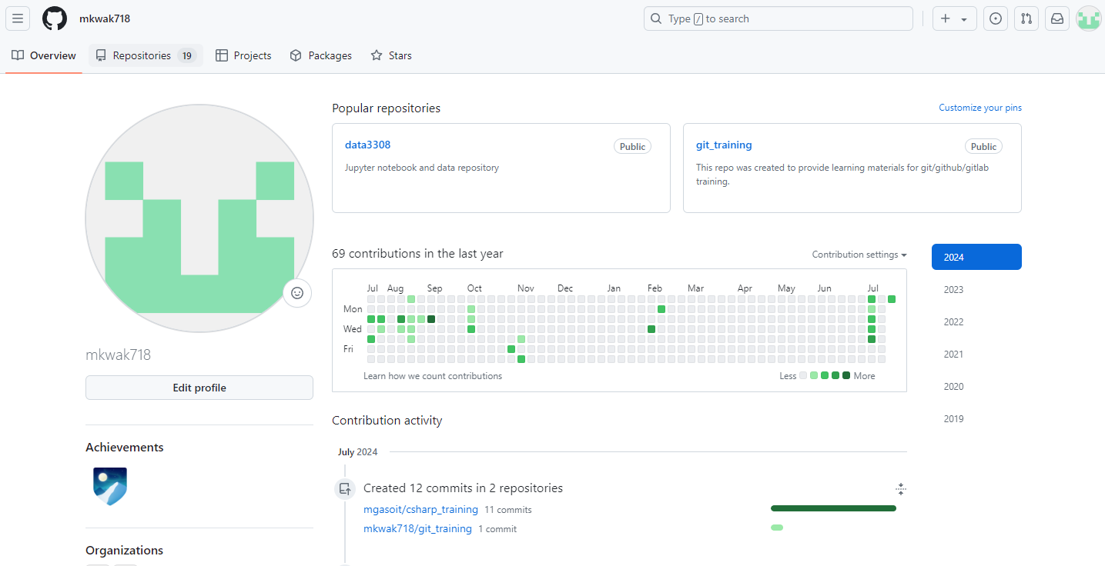
Creating a GitHub Repository
Go to github.com, create an account and login

Slide 7
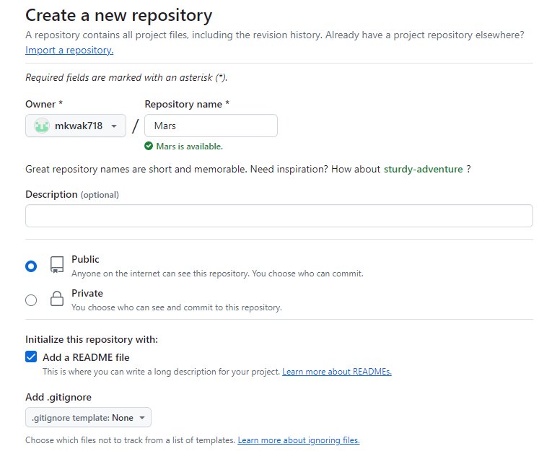
Creating a GitHub Repository
Create a new repository named ‘Mars’
Choose ‘Public’
Check ‘Add a README file’

Slide 8
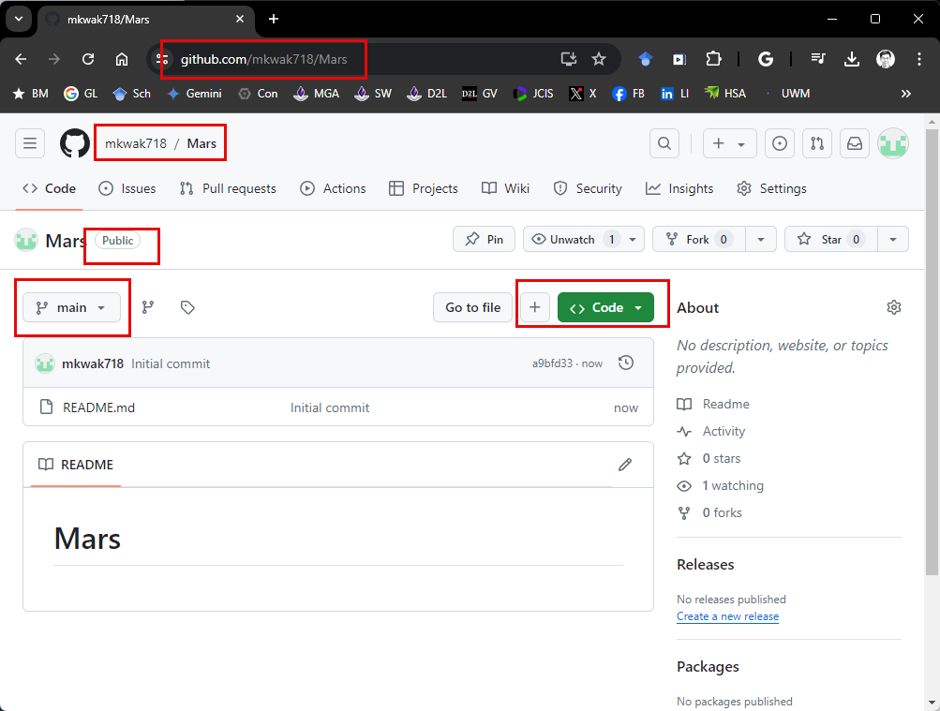
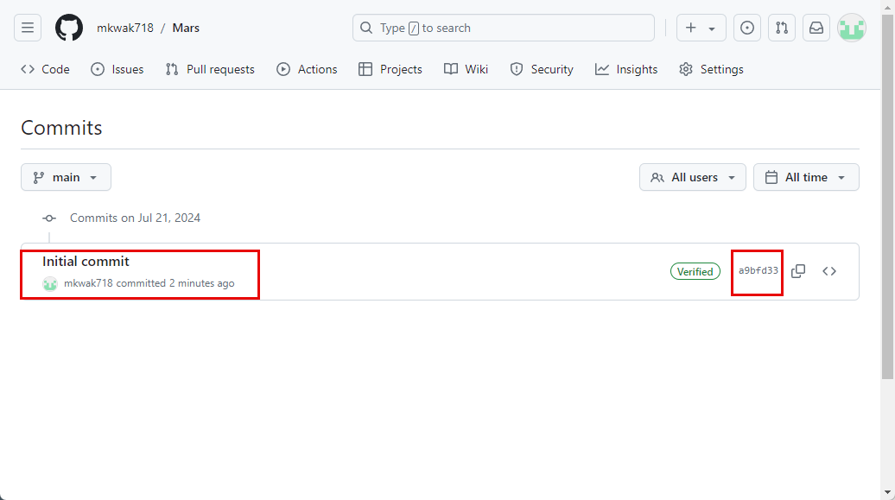
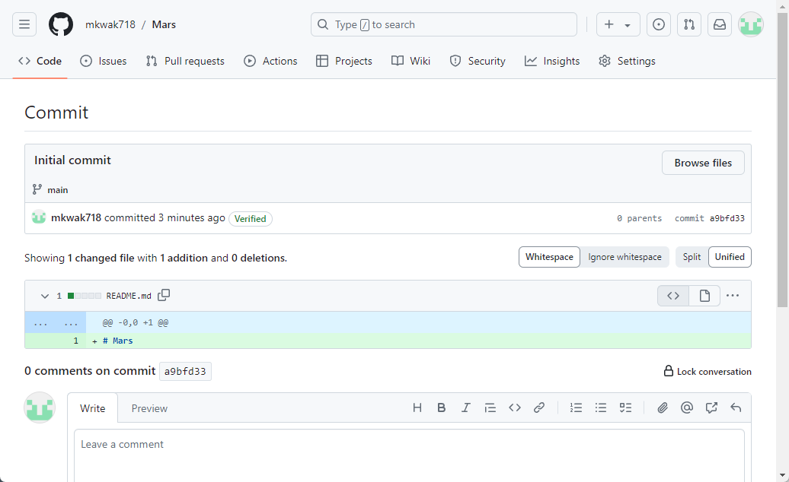

Slide 9
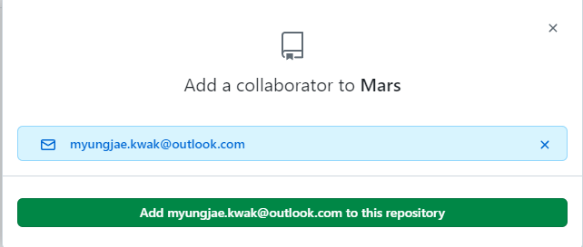
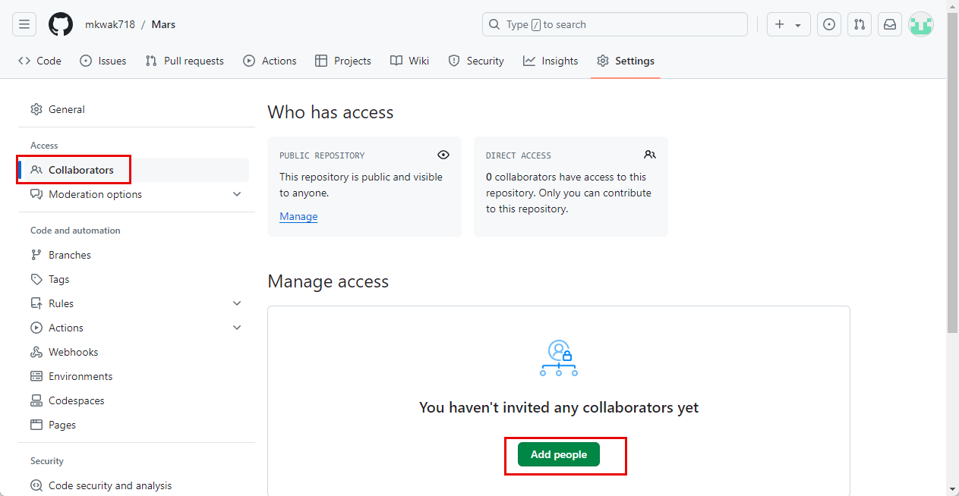
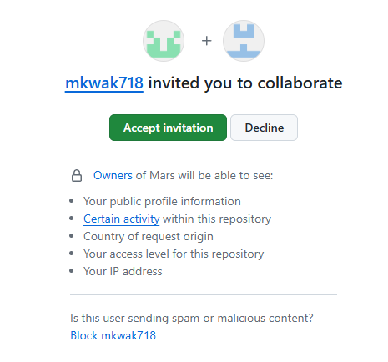
Adding Collaborators

Slide 10
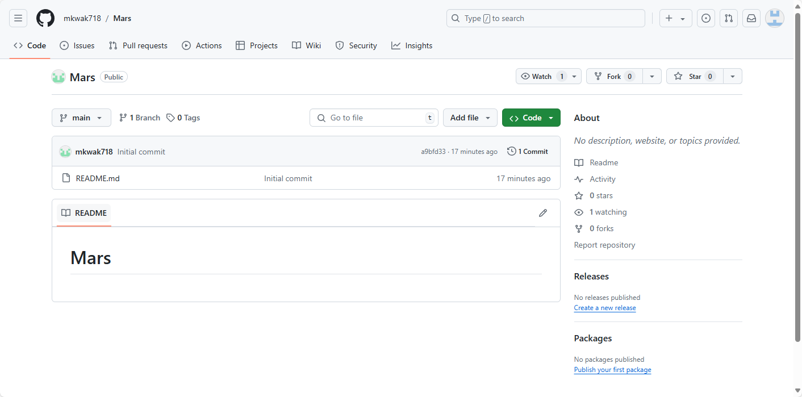
Collaborators can see the same repository.

Slide 11
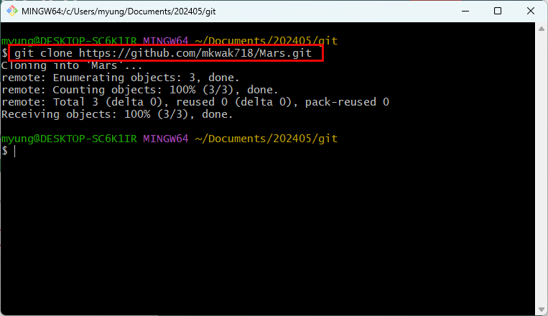
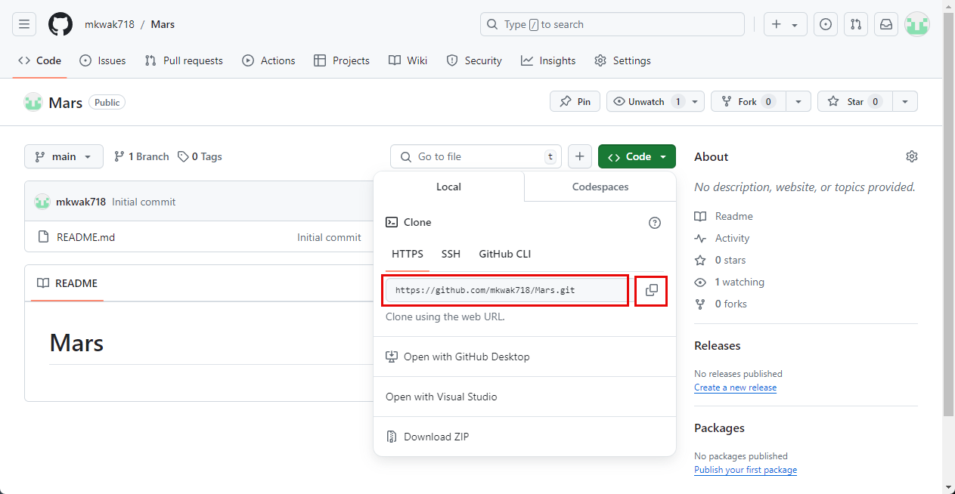
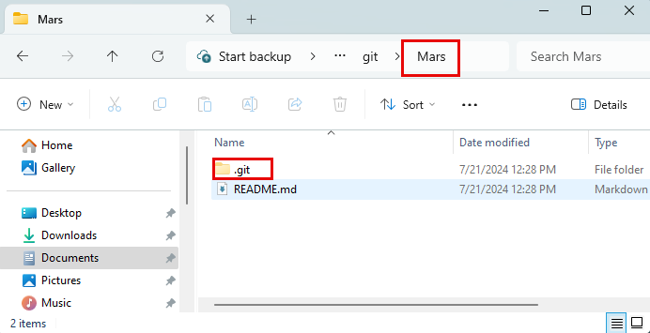
Cloning a Repository

Slide 12
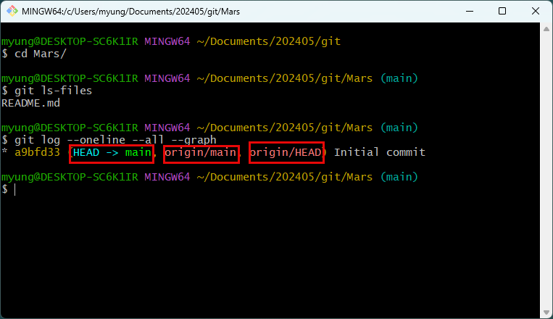
Currently there is a single commit.
‘HEAD -> main’: in the local (cloned) branch, HEAD is pointing to the main branch.
‘origin’ means remote repository.
‘origin/main’ means the local repository is referring to the main branch of remote repository.
‘origin/HEAD’ means the HEAD pointer of the origin (remote) repository is pointing to the current commit/snapshot.

Slide 13
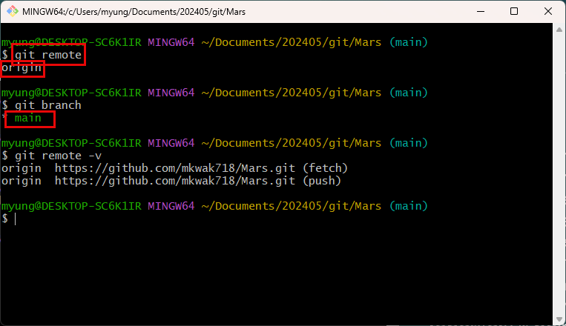
‘git remote’ shows remote repositories.
There is a single branch in local repository.

Slide 14
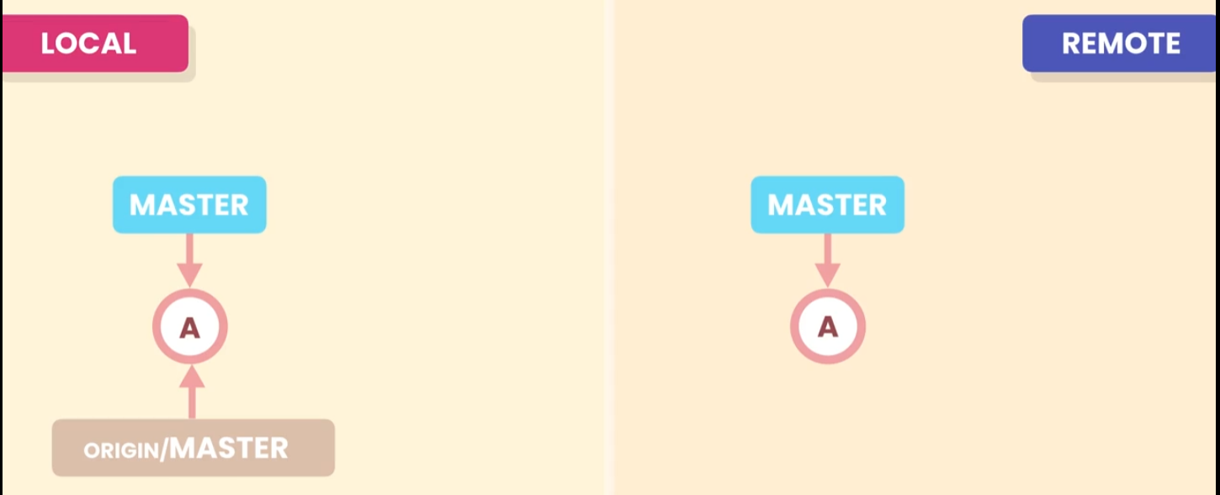
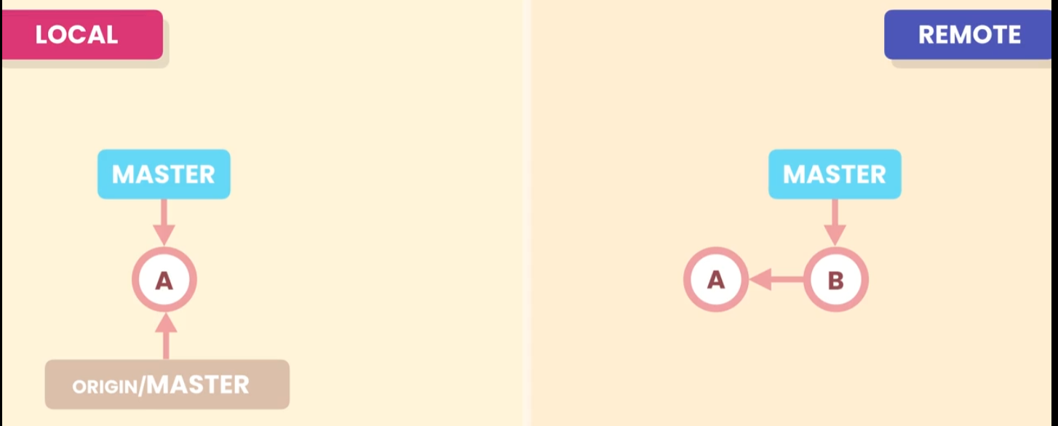
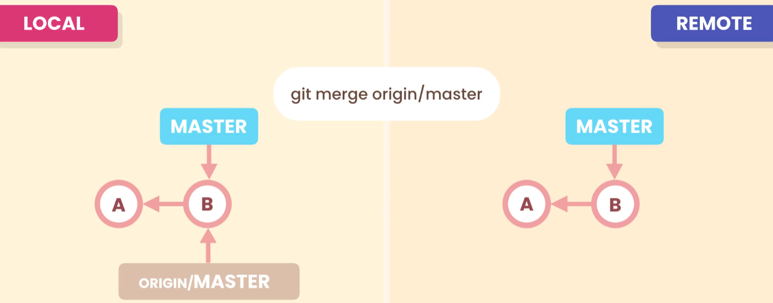
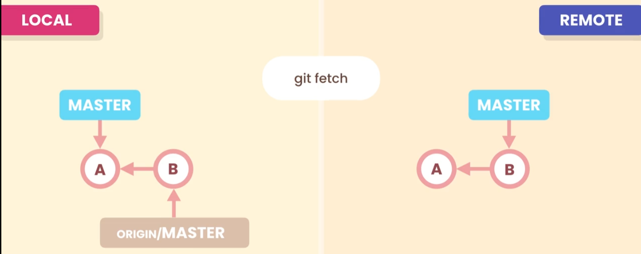
Fetching
This is fast-forward merging. If there is a conflict, you will need to resolve it.
Working directory is not updated at this point

Slide 15
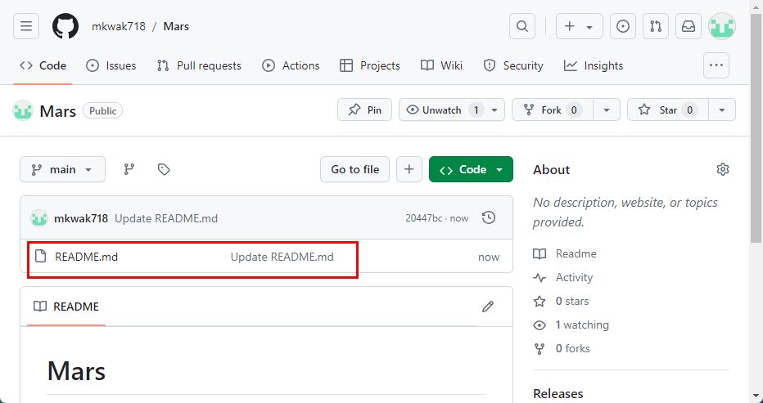
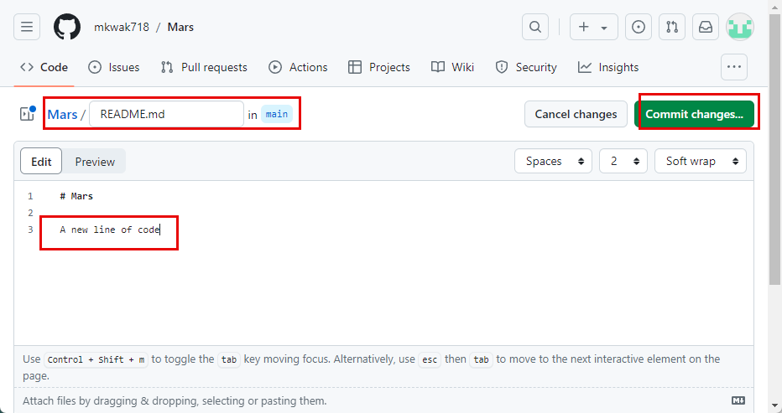
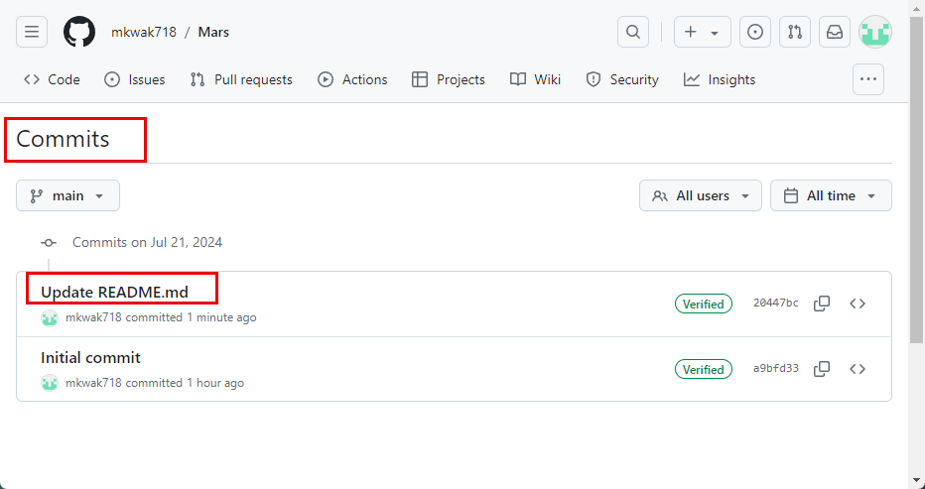
Using the web editor, modify ‘README.md’ file and commit changes.

Slide 16
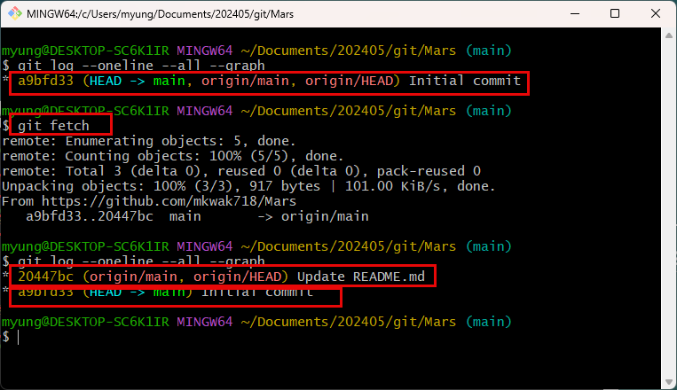
‘git fetch’ will execute ‘git fetch origin’ by default. You may specify a particular branch too.
You can see that local repository’s HEAD pointer was not updated.

Slide 17
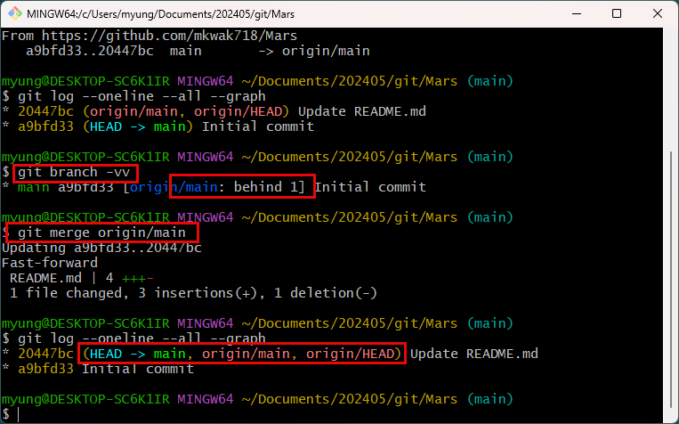
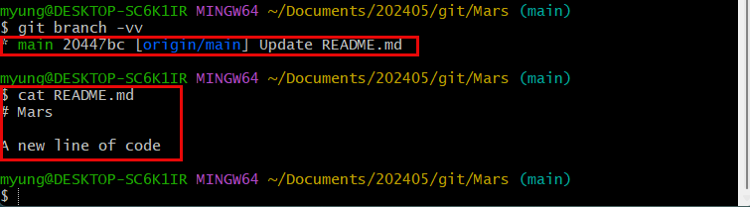
Now, you can see that local repository’s HEAD pointer was updated.

Slide 18
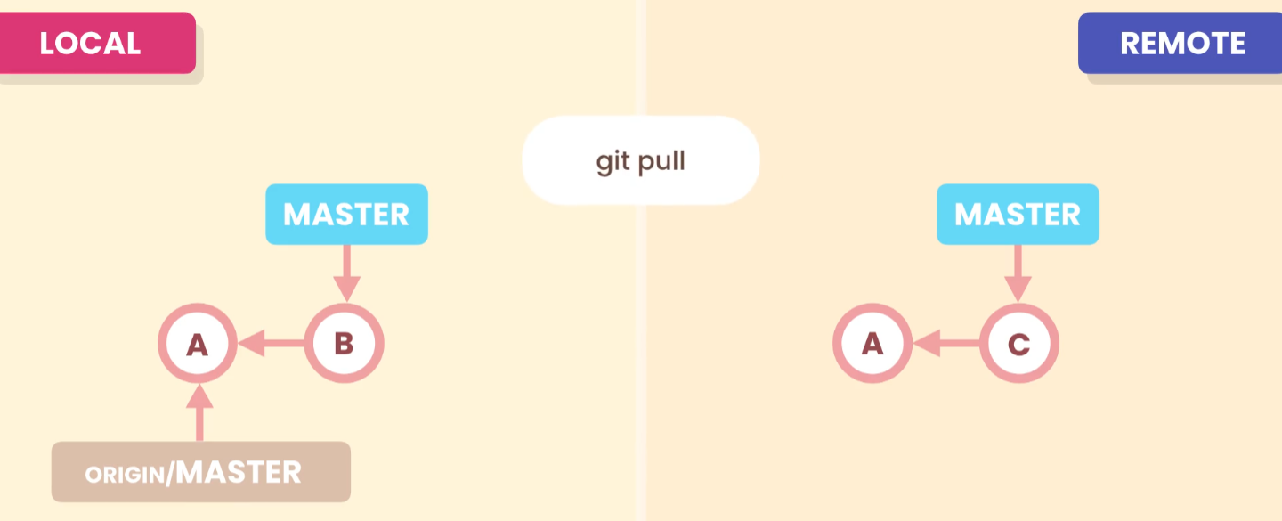
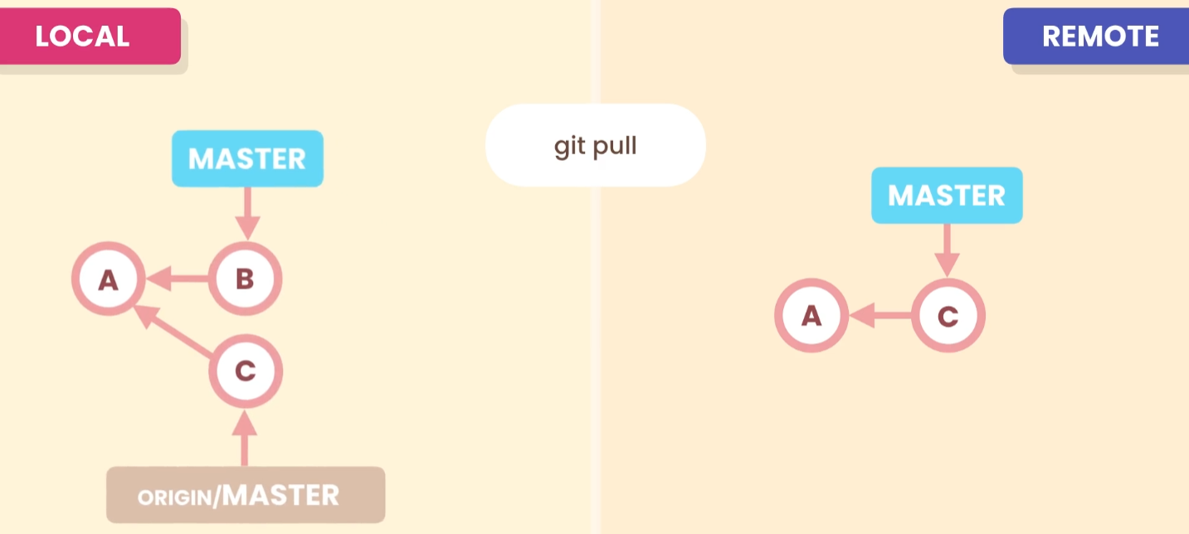
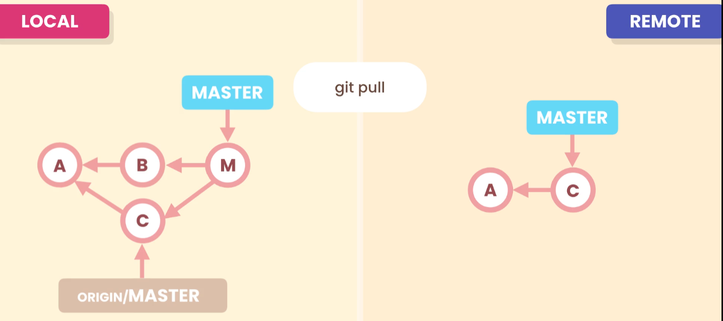
Pulling = Fetch + Merge
In this case, you will need to do 3-way merge.

Slide 19
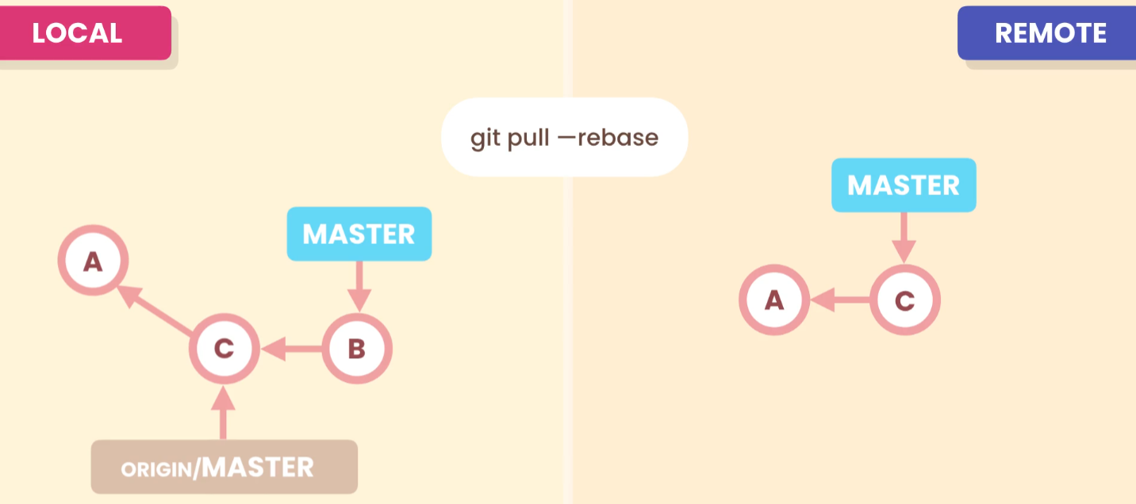
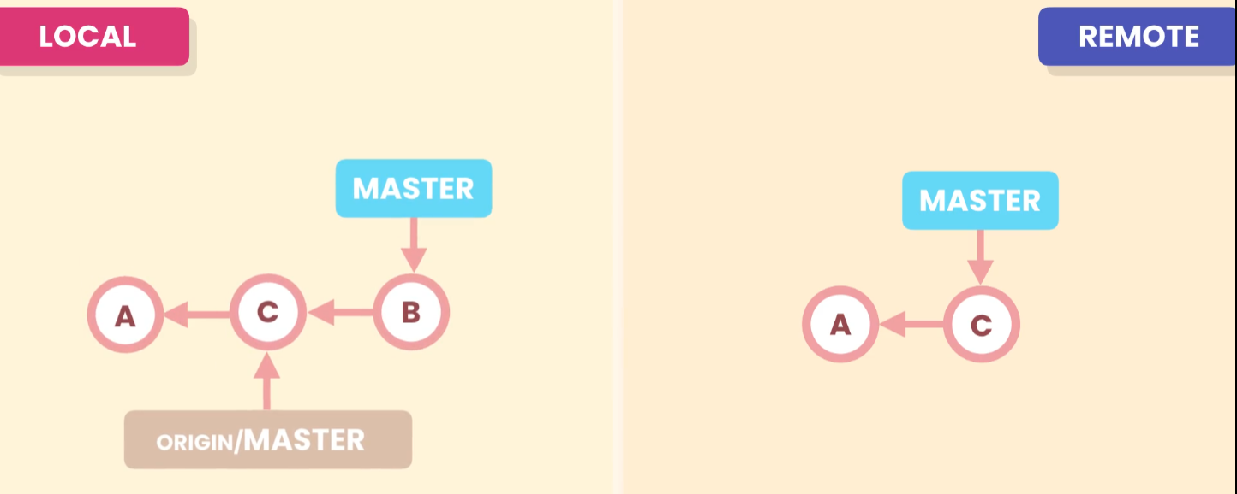
Alternatively, you can use ‘--rebase’ option. It will replace local commit on top of changes made by others and make the history linear.
Which is better?

Slide 20
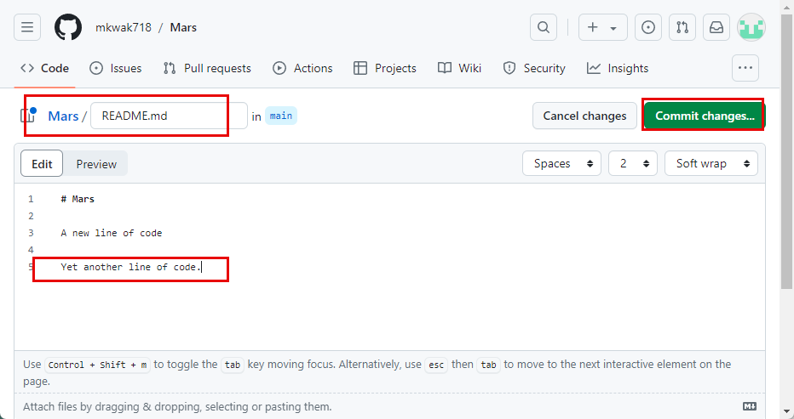
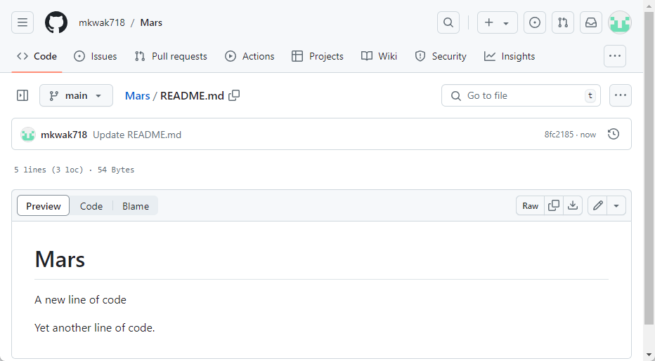

Slide 21
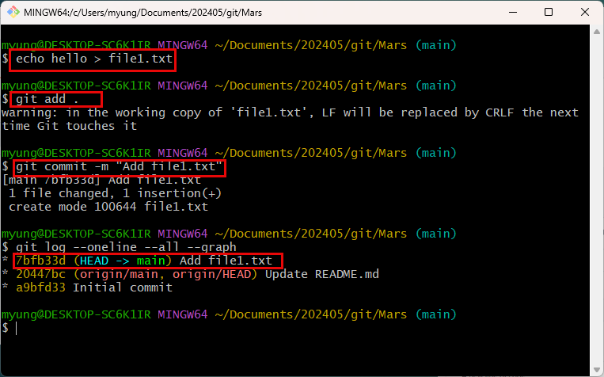
Before pulling the code from the remote, create a new file and commit it in local repository.
So, two repositories have diverged.

Slide 22
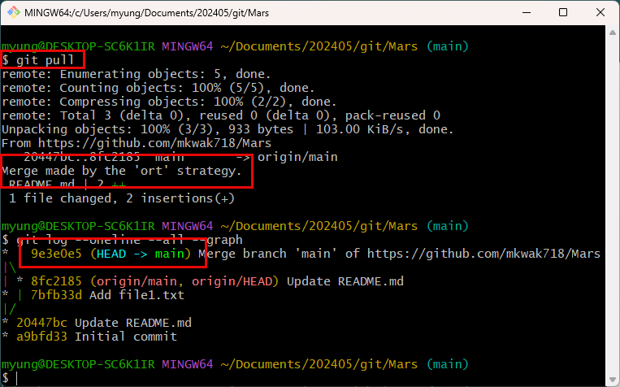
‘git pull’ command will do a 3-way merge.
If you don’t like it, you can undo the last commit, and execute ‘git pull --rebase’ command.

Slide 23
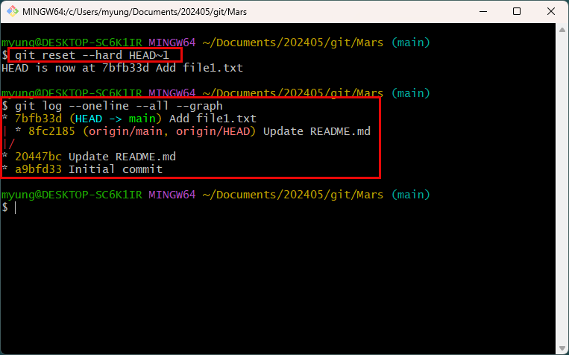
If you use ‘git reset --hard HEAD~1’, it will undo the last commit and put it back to the previous state.

Slide 24
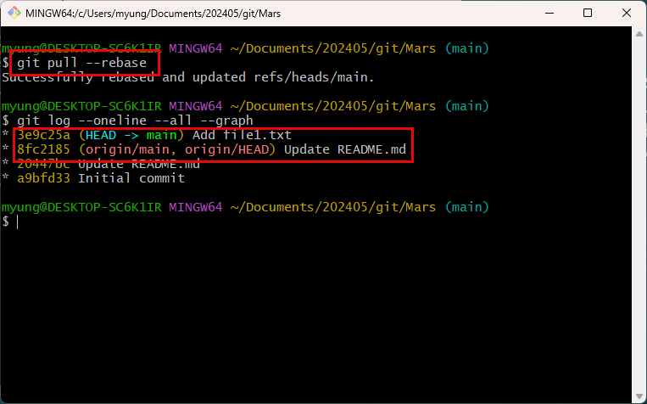
If you use ‘git pull --rebase’, it will merge and create a simple linear history.

Slide 25
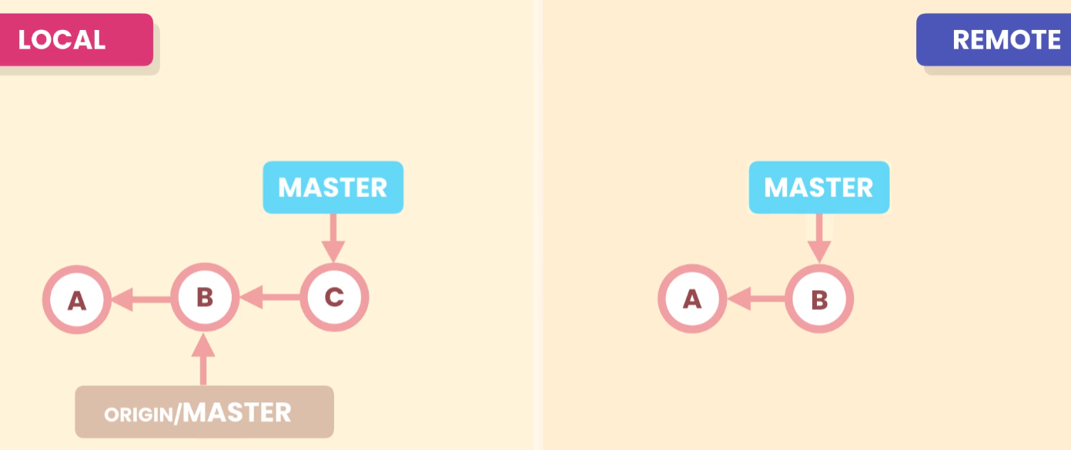
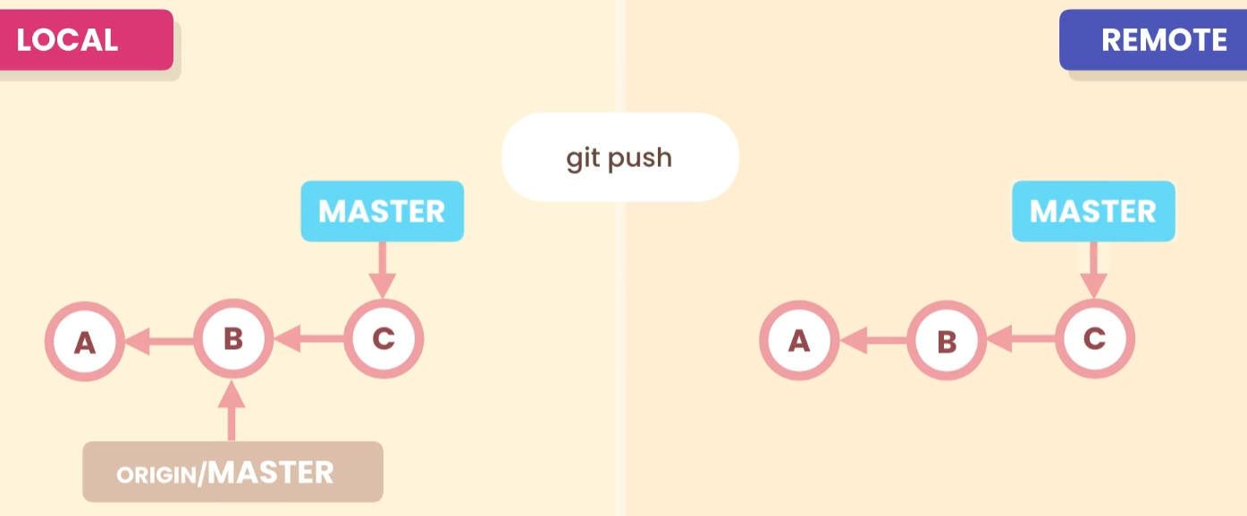
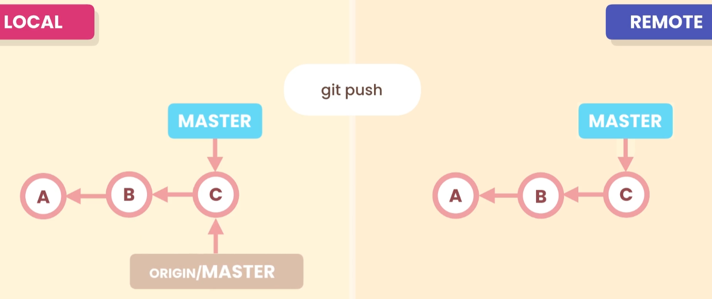
Pushing

Slide 26
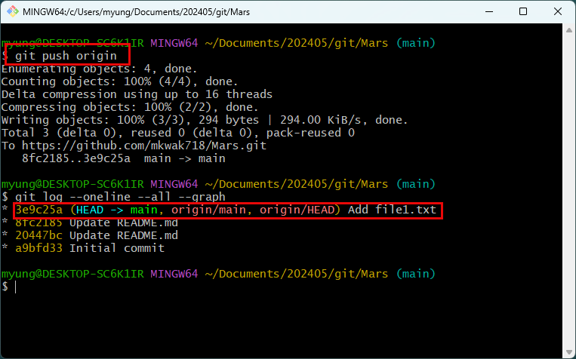
You can upload your code by using ‘git push origin main’, ‘git push origin’, or simply ‘git push’.
Now, you can see that local repositories are the same.
When you push for the first time, GitHub requires you to create a personal access token or generate ssh-key.

Slide 27
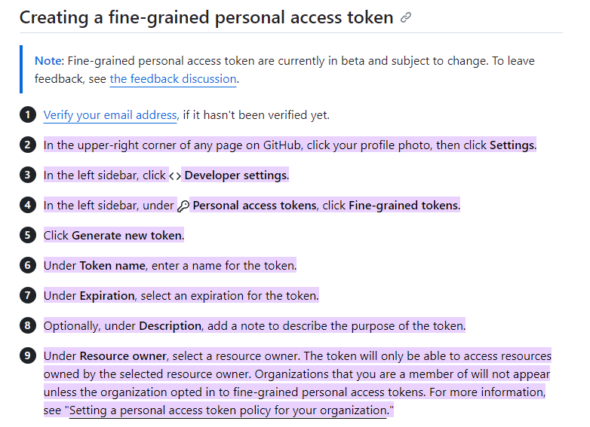
Create a personal access token
https://docs.github.com/en/authentication/keeping-your-account-and-data-secure/managing-your-personal-access-tokens

Slide 28



Slide 29

Push can be rejected
When two repositories have diverged, pull request can be rejected.
In this case, you can use ‘git push –f’, but it will drop other’s work.

Slide 30


In that case,
You pull the changes to local repository and merge the changes with your code. Then you can push your code.
Two repositories will be identical.

Slide 31
Sharing Tags
By default, the push command doesn’t transfer local tags to a remote repository.
So, you have to push them explicitly.

Slide 32



‘git tag v1.0’ will create a tag on the current snapshot.
If you want to push tags, you have to do it explicitly.

Slide 33

You can delete the tag in the remote.
In that case, the tag still exists in the local repository.
You can delete it too by using ‘-d’ option.

Slide 34

Releases

Slide 35

The tag will be attached to the current commit automatically.
You can always delete this release as needed.

Slide 36

Sharing Branches
If you want to create a new branch and share with others
You cannot simply push it to remote repository.

Slide 37

By using this command, yon can check whether a new local branch is linked to remote repo. In this case, it is not linked to a remote repository.
By using ‘git branch –r’, you can see all remote tracking branches.

Slide 38


You can create an upstream branch by using ‘-u’ option.

Slide 39

You can delete remote branches
You can delete the ‘feature/change-password’ branch using ‘–d’ option.
But it still exists in the local repo.

Slide 40

To delete the ‘feature/change-password’ branch in the local repo,
Switch to the main branch and delete it by using ‘-d’ option.

Slide 41


Collaboration Workflow
You can create a new branch using the web app.

Slide 42

If you fetch the remote repo, it will get the new branch information, but the local branches are still not updated.
But the remote tracking branches are up-to-date.

Slide 43

This command will create a new branch ‘feature/change-password’ in the local repo, which is set up to track the remote ‘feature/change-password’ branch.

Slide 44


Collaborator
Another team member (Kwak) cloned the remote repo to work on new feature.
In his local repo, he only can see only the main branch.
So, he must create the feature/change-password branch in his local repo.

Slide 45


Kwak creates a new file in the new branch and make a commit.
Then pushes the changes.
** may have to sign in and provide your credentials.

Slide 46


Now the push was successfully made.

Slide 47

From your computer
If you run the pull command, you can see that Kwak’s code was successfully merged to your local branch (in this case there is no conflict).

Slide 48

Merging two branches
To finish the merge two branches, you need to switch to the main branch
Then merge the feature/change-password branch
You see the pointers of the remote repo are one commit behind.
So, you need to push your changes to the remote repo.

Slide 49

Now, pointers at both repos are pointing to the same location.

Slide 50


Once you are done with the feature branch, you can delete it from the remote repo.
But the feature branch is still in the local repo.
So, you will need to delete it too.

Slide 51

For Kwak’s standpoint, to clean up the feature branch
He needs to switch to main,
Execute pull command to get up-to-date snapshot
Delete the local feature branch
Then clear the remote tracking branches using prune command.

Slide 52

Now, the feature branch was removed.

Slide 53


Pull Requests
Assume Kwak wants to work on a new feature…
Create a new branch
Create a new file on the branch and commit.

Slide 54

Then push the branch.
In this case, you have to use ‘–u’ option

Slide 55

New branch is created.

Slide 56


If you click ‘New pull request’, it will compare two branches and show the differences.
If there is no conflict, it will display “There branches can be automatically merged.”

Slide 57


Slide 58

After creating pull request, ask another team member to review the merge.
** Kwak should have created this request. But doesn’t really matter.

Slide 59

If the requested team member logs in, he will see the request and can add his review.

Slide 60


Slide 61



Slide 62

Kwak makes necessary changes and pushes again.

Slide 63

Then ask review again.

Slide 64



Slide 65



Slide 66



Once the review process is done, someone (usually not the person who initiated this branch) creates this Merge pull request.

Slide 67

From Kwak’s computer,
Switch to main
Pull the changes
Can see the feature branch was successfully merged to main branch.
No longer need the feature branch. So, delete it.

Slide 68

Remove the feature branch from the local repo and remote tracking branches.

Slide 69

Resolving Conflicts
Kwak started a new branch to work on some other features.
So, he created a new branch named ‘feature/logout’
Added a new file.
Made a commit
Pushed to remote

Slide 70

Therefore, new branch is created in the remote repo

Slide 71

Kwak switched to main and modify the same, file1.txt, made a commit and pushed the changes, which will create a conflict.
It is because the master and the new feature branches have diverged.
Kwak wants to move forward and starts pull request

Slide 72


When Kwak makes a pull request, he will get a conflict error.

Slide 73

Kwak continues to make a pull request.

Slide 74

Then he gets this.
So, someone needs to resolve these conflicts and merge them manually.

Slide 75



Someone needs to resolve the conflicts and mark as resolved.

Slide 76




Slide 77


Kwak needs to pull again and removes the feature branch from local and remote tracking branches

Slide 78
Summary

Slide 79
Exercises

